Slide 1

FIFA EDA and Player’s Rating Prediction
TEAM 1
Divyesh Rajput
Vrushank Hiremath

Slide 2
Contents
Introduction
Exploratory Data Analysis
Data Pre-processing
Machine Learning Models
Conclusion
Reference

Slide 3

Introduction
FIFA is a popular video game franchise that allows players to build teams using real-world football players.
Players in the game are rated based on their abilities and skills, with ratings ranging from 40-97.
Our project uses FIFA data to predict player ratings accurately by analyzing their skills and performance attributes.
This helps gamers make informed decisions while selecting players and building their teams.
Additionally, the data we collect can be used by professional teams and coaches to make informed decisions during the transfer season or while drafting new players.

Slide 4

Problem Statement
Explore the data to understand the distribution of player attributes, identify patterns and trends, and answer interesting questions about the world of football.
Through this data science project, the aim to provide valuable insights to football enthusiasts, analysts, and researchers, who can use the information to understand the game better, predict player performance, and make informed decisions. Goal is to predict a player’s rating in the latest edition of the FIFA Game.

Slide 5

Dataset
Every player’s detail available from FIFA 15, 16, 17, 18, 19, 20, 21, 22, and FIFA 23
All FIFA updates from 10th September 2015 until 13th January 2023
110 attributes
Player positions, with the role in the club and in the national team
Player attributes with statistics as Attacking, Skills, Defense, Mentality, GK Skills, etc.
Player personal data like Nationality, Club, Date Of Birth, Wage, Salary, etc.

Slide 6
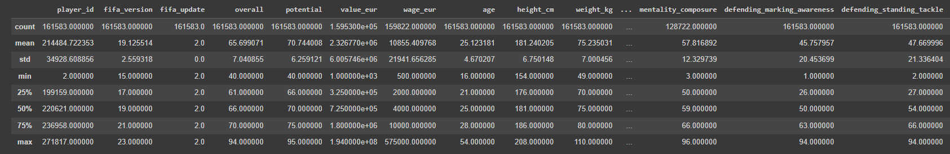
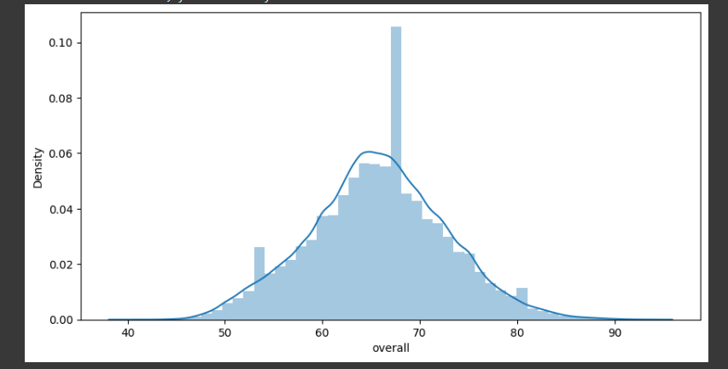
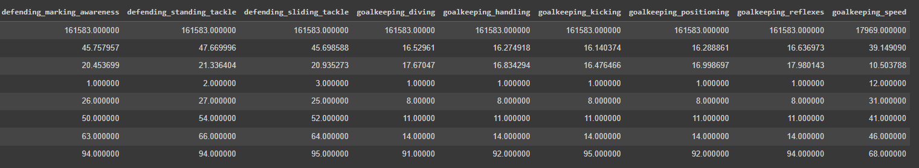
Exploratory Data Analysis

Slide 7
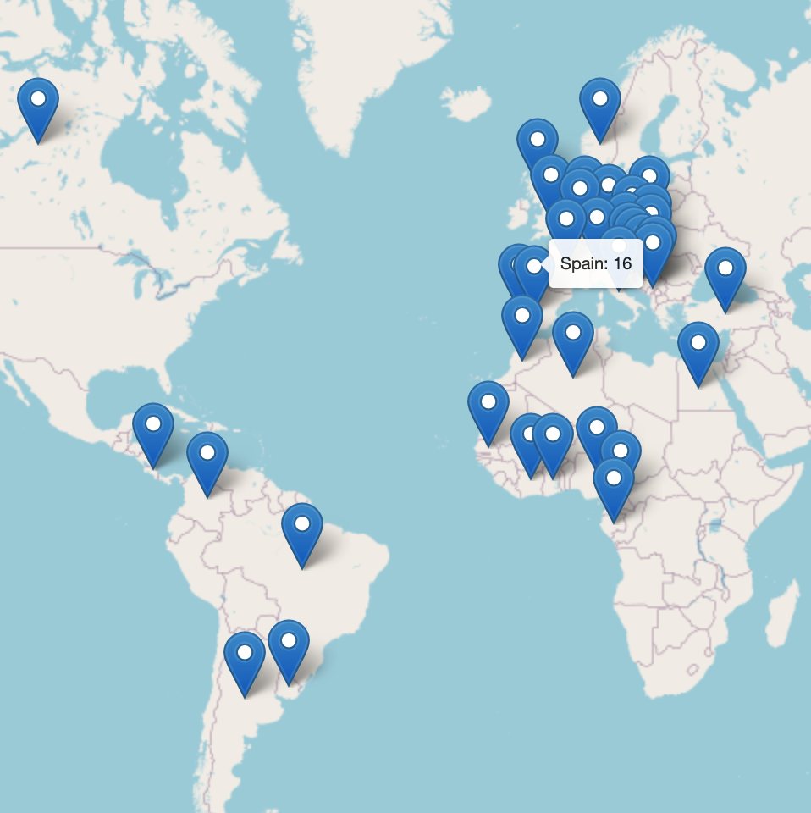
Nationality wise Distribution of Top 150 Players

Slide 8
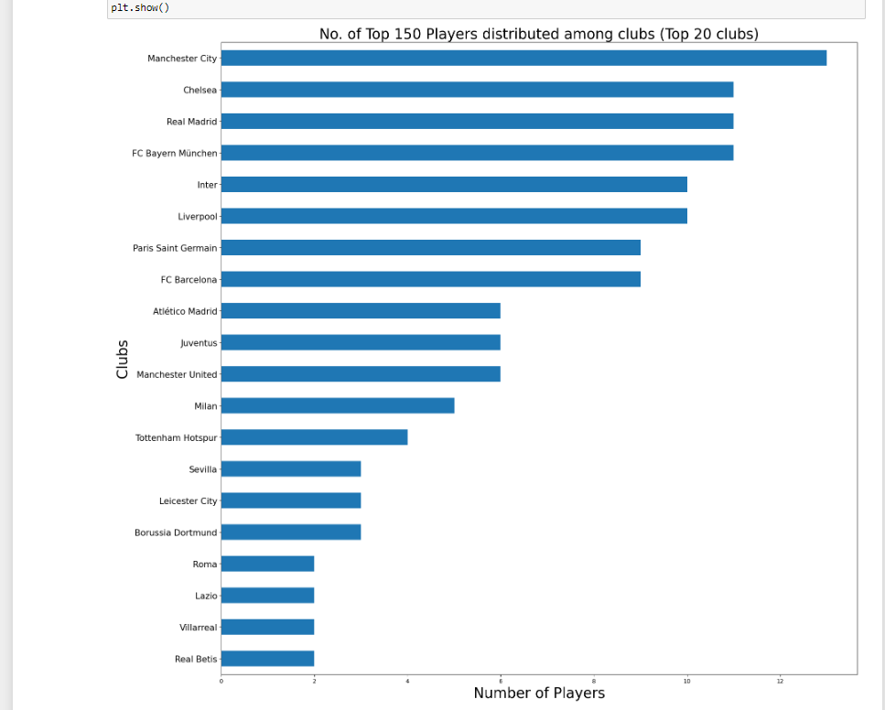
Top 150 Players distributed among clubs (Top 20 clubs)

Slide 9
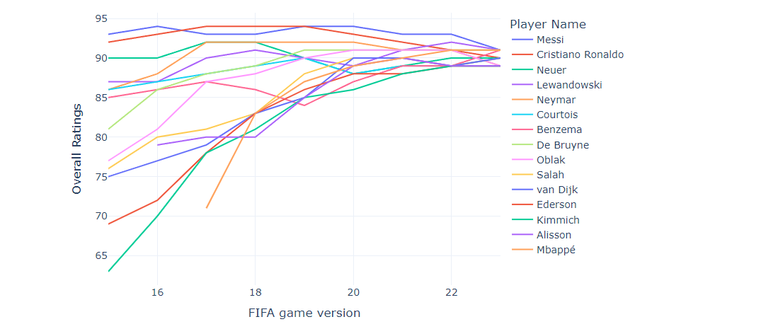
Overall Rating of the Top 15 players over the time

Slide 10
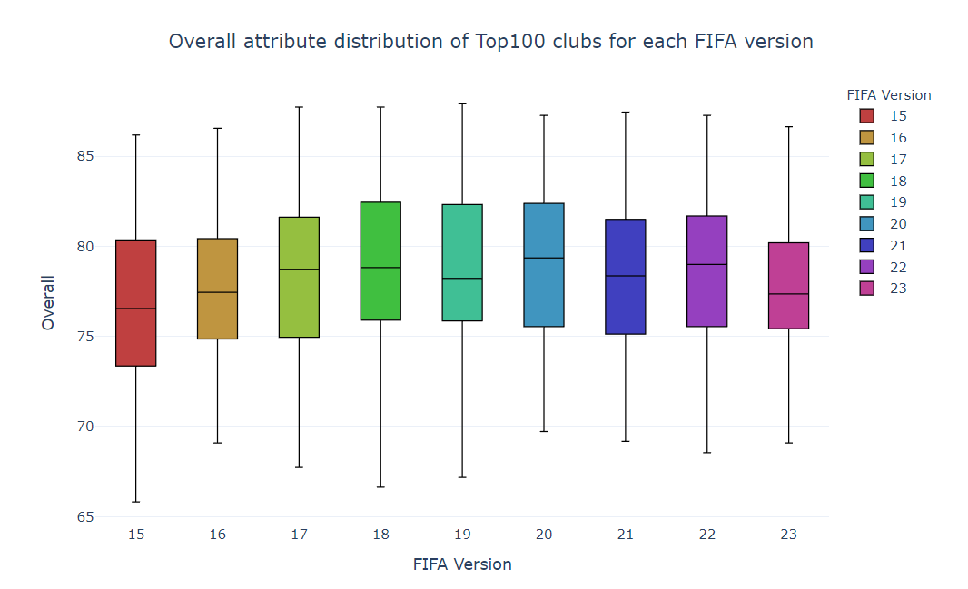
The highest average rating a lineup has ever had was Barcelona in FIFA 19, with an average player attribute in the 11-man lineup of 87.9, even higher than Liverpool in FIFA 21 (87.4 average player rating in the best lineup).

Slide 11
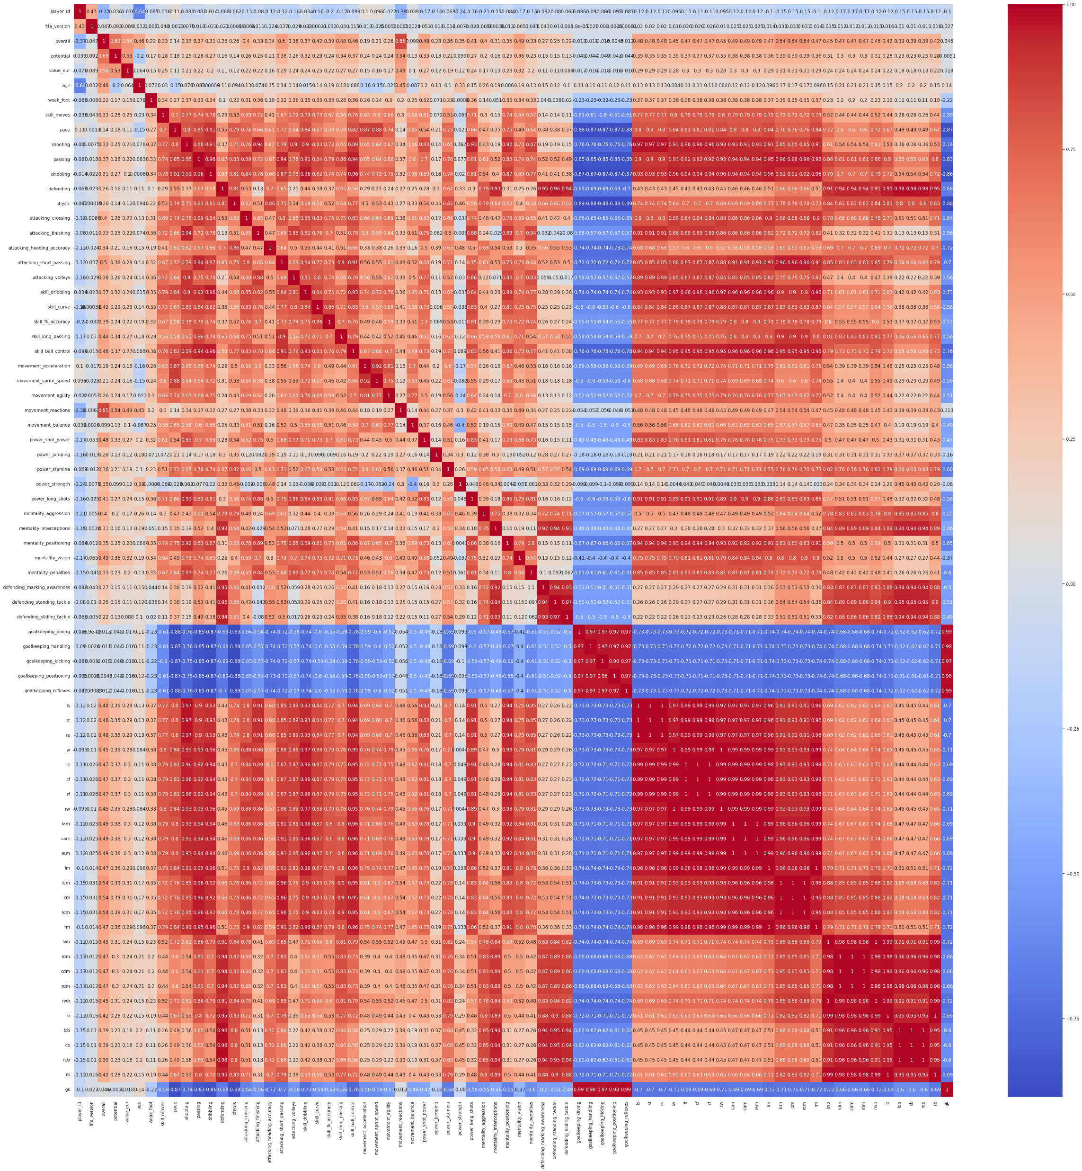
Correlation Matrix

Slide 12

Data Pre-processing
The dataset was already pre-processed and partially cleaned by the data provider.
Some columns that were not relevant to the analysis were removed to reduce the dataset size and complexity.
Missing values in the dataset were replaced with 0, if the missing values meant that the player did not have a certain attribute or skill.
The data was checked for duplicates and any duplicate entries were removed to avoid any biases in the analysis.
The dataset was further filtered to include only the players who have played at least one international match, to focus the analysis on the best players in the world.
The final pre-processed dataset was then used for further analysis and modelling.

Slide 13

Training And Testing Dataset
Two Dataframes are created by splitting dataset.
Training set contains data from 2015-2022 i.e., FIFA version 15 – 22.
Testing set contains data of 2023.
This ensures that the machine learning model learns to generalize well, and that the evaluation of the model's performance is accurate.

Slide 14
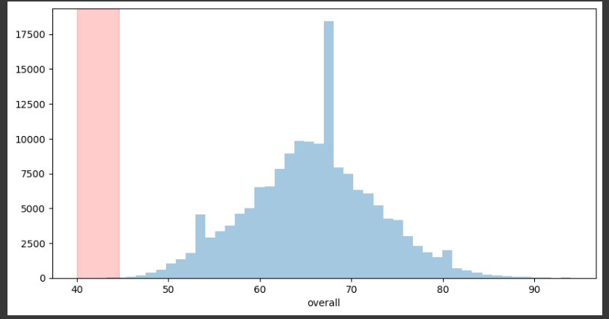
Data Pre-Processing continued…
Outliers are data points that are significantly different from other data points in a dataset. Outliers can be caused by various factors such as measurement errors, data entry errors, or rare events.
Removing Insignificant columns
Feature Combining based on the correlation matrix

Slide 15

Machine Learning Models
Simple Linear Regression
Decision Tree Regressor
Random Forest Regression

Slide 16

Regression: Simple Linear Regression
Simple linear regression is used to estimate the relationship between two quantitative variables.
Linear regression is used to describe the relationship between variables by fitting a straight line to the observed data.
Assumptions:
Homogeneity of variance
Independence of observations
Normality
Linear relationship between independent and dependent variable.

Slide 17
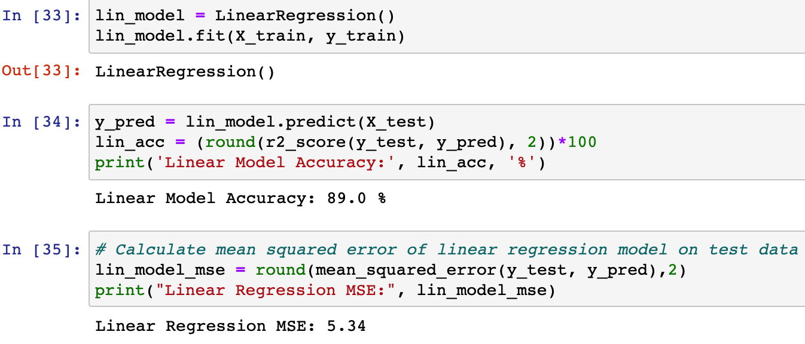
Code Snippet

Slide 18
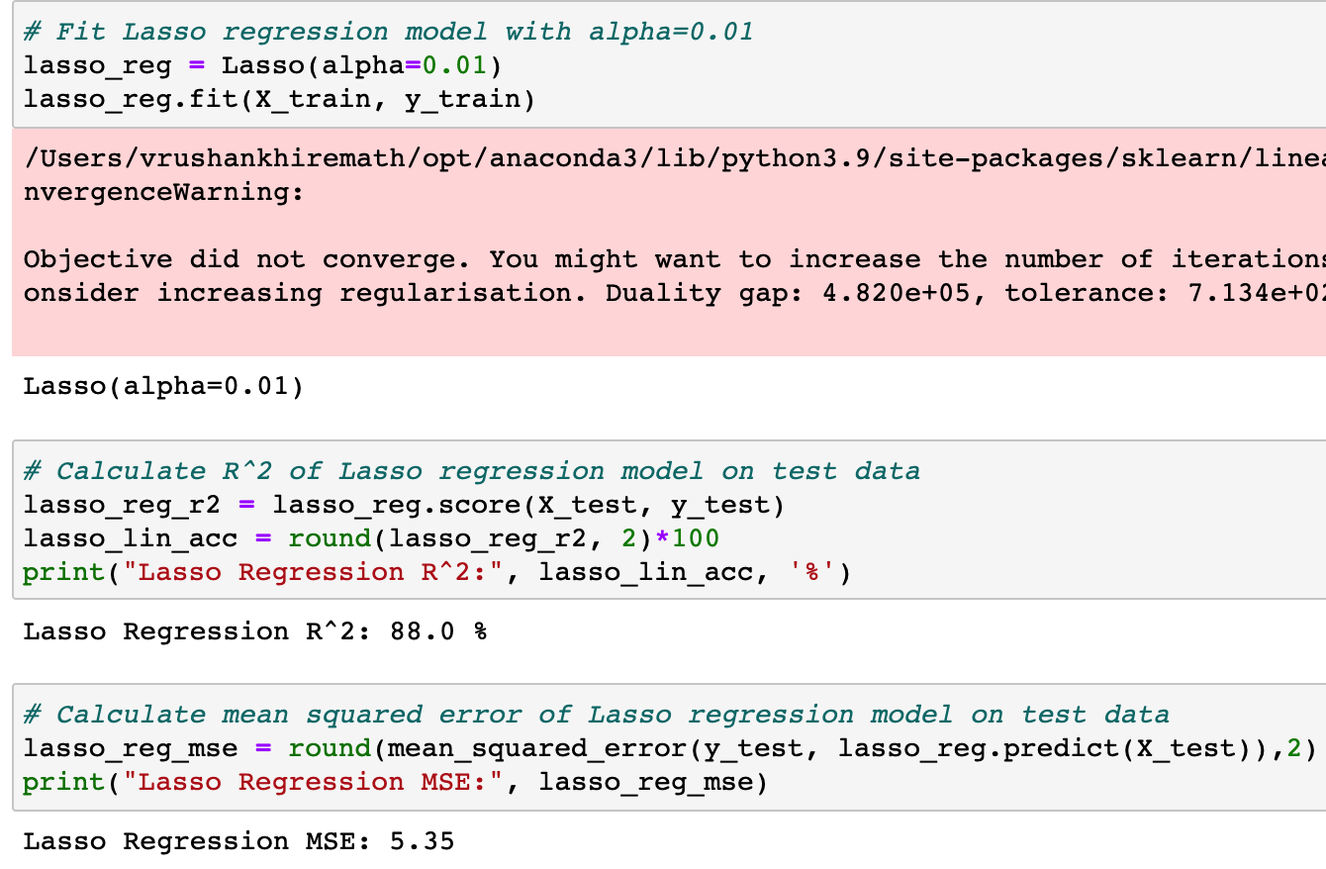
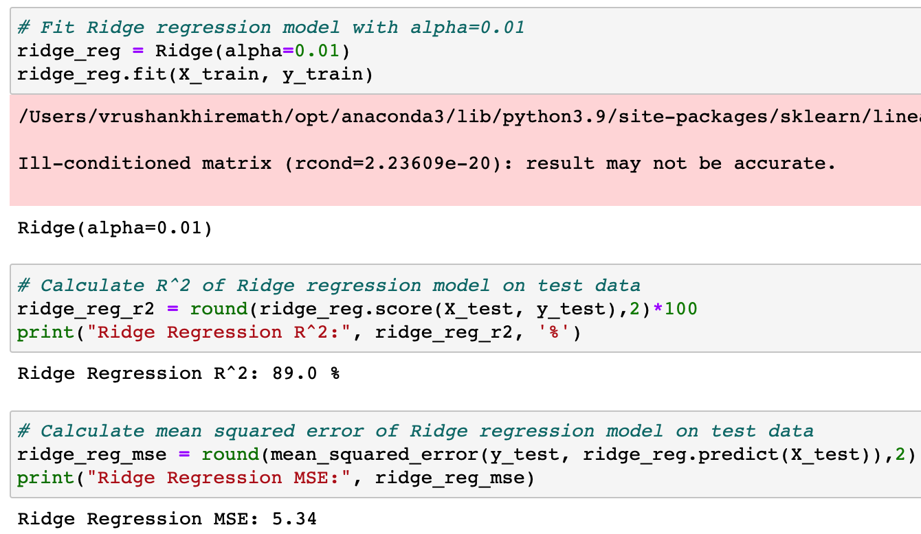
Ridge and Lasso Regression
Notes:
Ridge regression is a linear regression technique that is used to deal with multicollinearity in data, which occurs when the independent variables are highly correlated with each other.
The technique involves adding a penalty term to the cost function of the linear regression model, which shrinks the coefficients of the independent variables towards zero. This reduces the impact of the independent variables on the model's predictions, thus reducing the model's sensitivity to multicollinearity.
Similar to ridge regression, Lasso regression adds a penalty term to the cost function of the linear regression model. However, in Lasso regression, the penalty term is the absolute value of the coefficients of the independent variables. This leads to sparse solutions, where some coefficients are set to zero, effectively removing those features from the model.

Slide 19
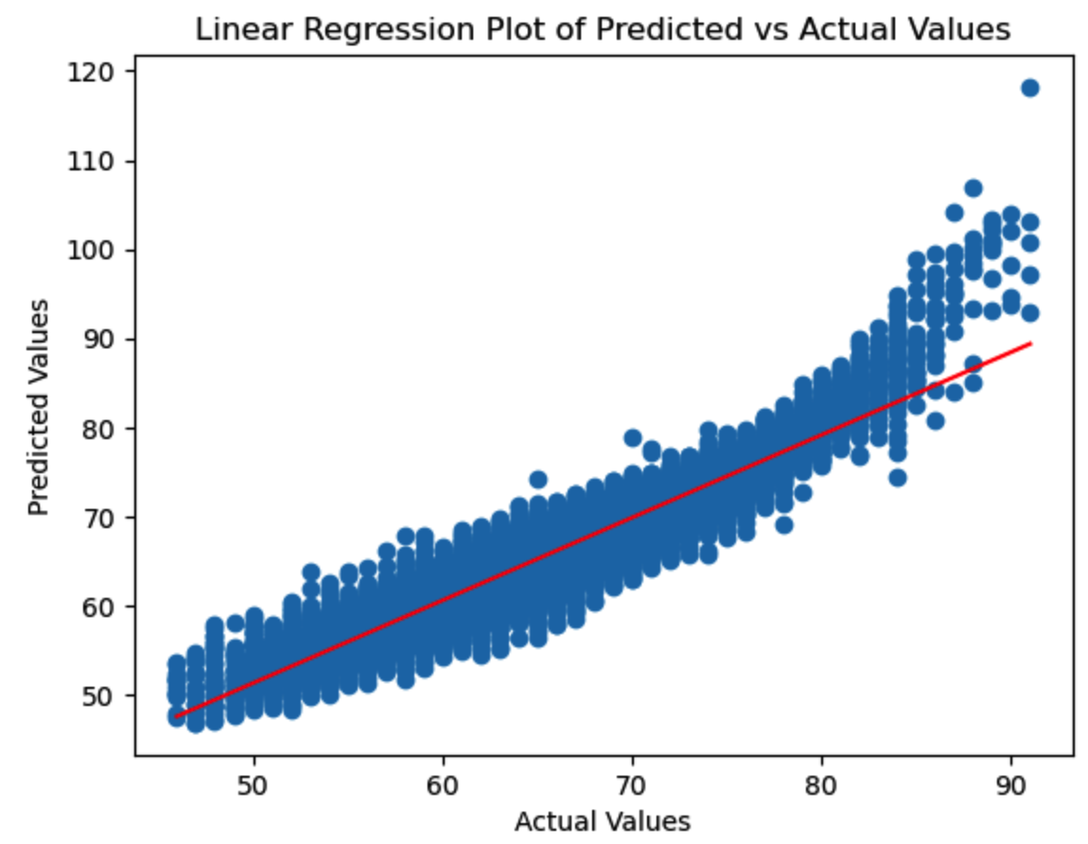
Analysis

Slide 20
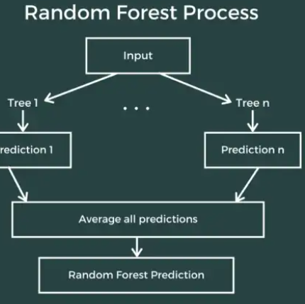
Regression: Random Forest Regression
Random Forest Regression creates multiple decision trees using a technique called Bagging.
Bagging involves training all the decision trees on a different data samples.

Slide 21
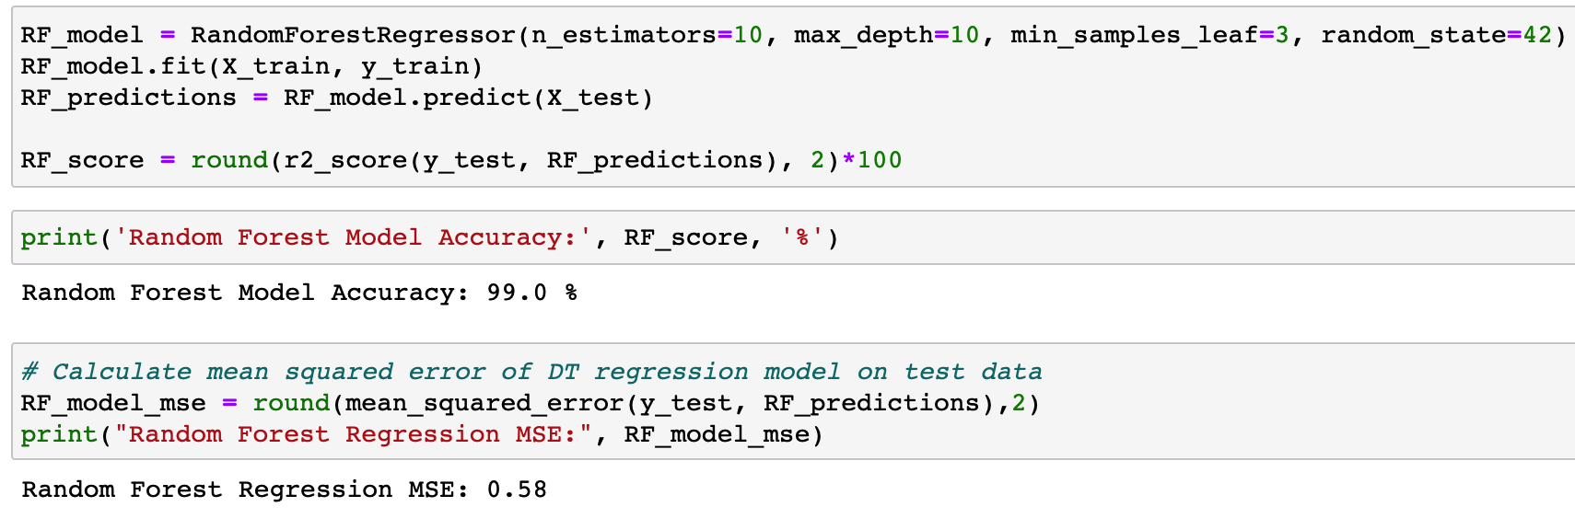
Code Snippet

Slide 22
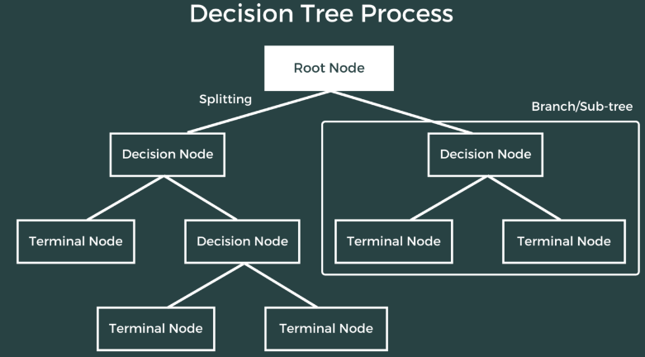
Regression: Decision Tree Regressor
Decision tree builds models in the form of a tree structure.
It breaks down a dataset into smaller and smaller subsets while at the same time an associated decision tree is incrementally developed.
The final result is a tree with decision nodes and leaf nodes.

Slide 23
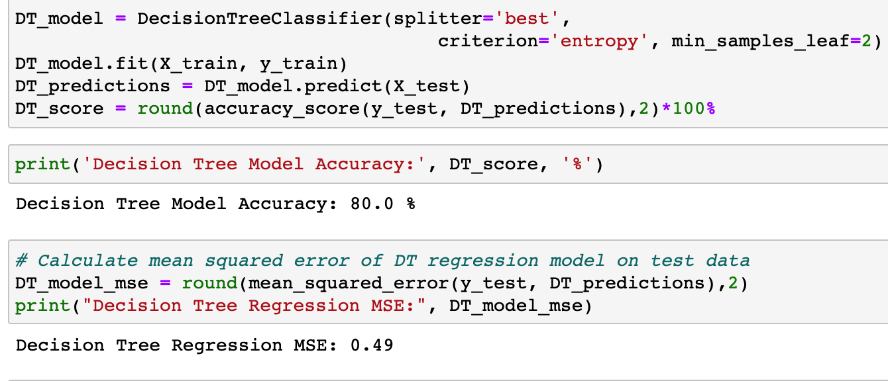
Code Snippet

Slide 24
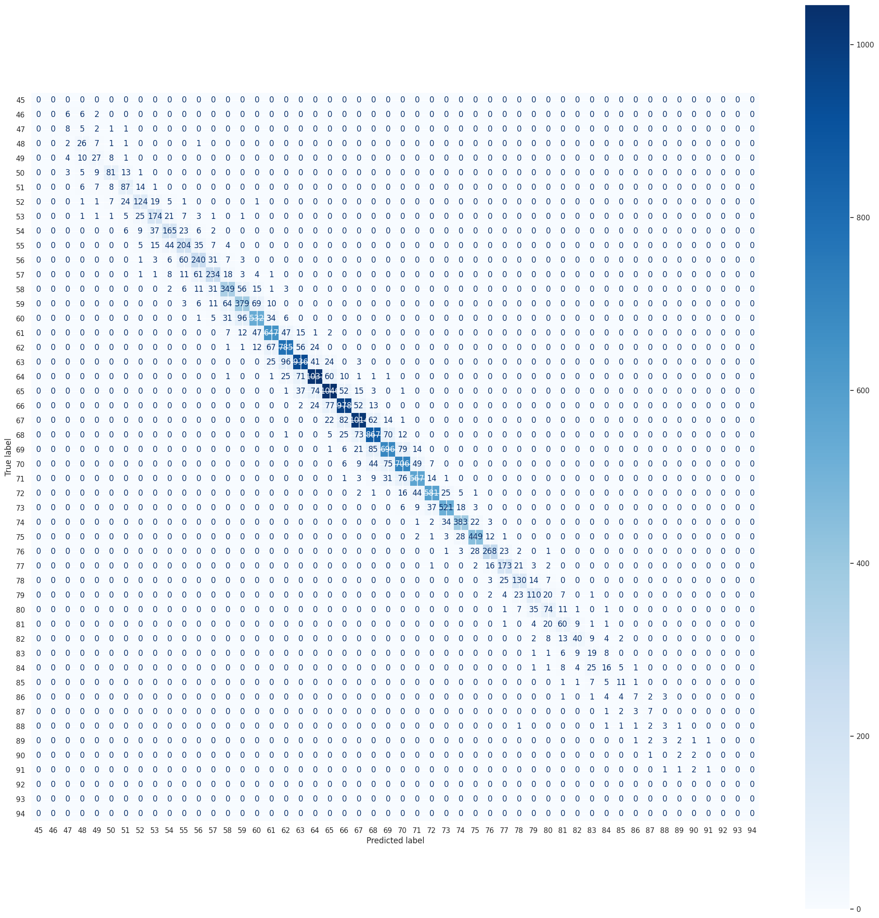
Confusion Matrix
Comparing actual values and predicted values
The confusion matrix can also be used to optimize the machine learning model. By analyzing the matrix, one can identify areas where the model is making mistakes and take corrective actions such as adjusting the model parameters or modifying the features used in the model.

Slide 25
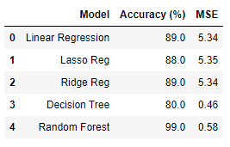
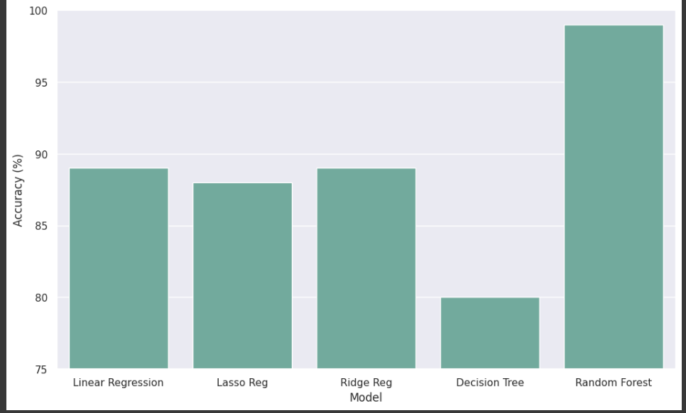
Model Comparison

Slide 26
Conclusion
Random forest algorithm delivers the highest accuracy for the given dataset.
Random forest consistently outperforms other machine learning methods such as decision trees and logistic regression.
The effectiveness of the random forest algorithm is due to its ability to handle large datasets, deal with missing values, and reduce overfitting.
Based on the findings, it is recommended that the random forest algorithm should be used for further investigation and predictions on this dataset.

Slide 27
References
https://www.kaggle.com/datasets/stefanoleone992/fifa-23-complete-player-dataset
https://uruit.com/blog/soccer-and-machine-learning-tutorial/#23_Support_Vector_Regression
https://www.kaggle.com/code/eugeniyosetrov/end-to-end-house-prediction-with-98-r2-score

Slide 28

Thank You

